Slide 1
Introduction to Robotics
CSE 461
Lecture 10: Introduction to Control System Theory
Niloy Irtisam
Lecturer, Dept. of Computer Science and Engineering
Brac University

Slide 2
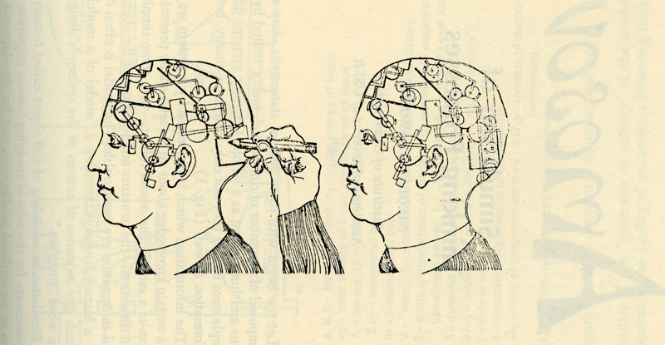
Cybernetics
The term "cybernetics" comes from the Greek word "kybernetes," which means "steersman" or "governor." In cybernetics, this refers to the process of controlling or regulating a system by providing feedback. It involves the study of how systems, both biological and artificial, process information, adapt to changes in their environment, and communicate with each other.

Slide 3
How things get controlled
Control Systems Example
Body temperature regulation
• If cold, shiver (muscles produce heat)
• If hot, sweat (evaporation takes away heat)
Maintaining social peace
• If a crime is found (sensor), the guilty party is punished (actuator).
Cruise control in cars
• You set a speed, Cruise control will increase fuel intake uphill, and decrease it
downhill.
• Etc...

Slide 4
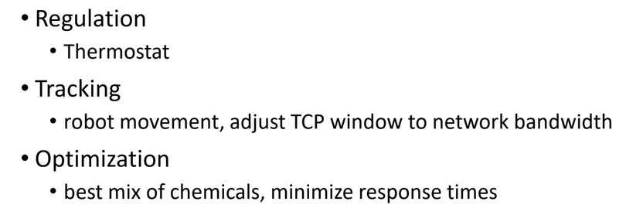
Control System Goal

Slide 5
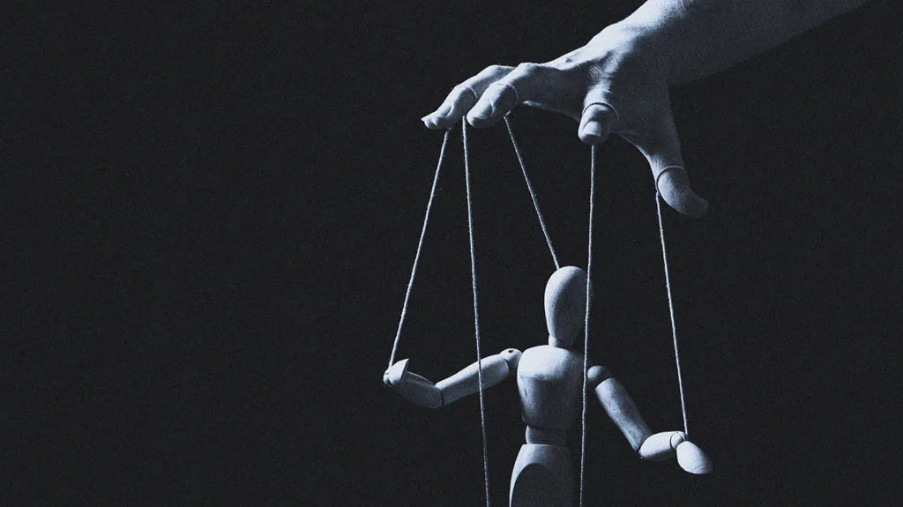
Control Theory

Slide 6
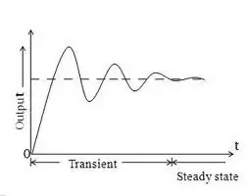
Why Control Theory
Systematic approach to analysis and design
• Transient response
• Consider sampling times, control frequency Taxonomy of
basic controllers (PID, open-loop, Model-based,
Feedforward...)
• Select controller based on desired characteristics
Predict system response to some input
• Speed of response (e.g., adjust to workload changes)
• OsciIIations (variability)
Assessing stability of system

Slide 7
Control System
Controller
3 rad/sec
2.2 rad/sec

Slide 8
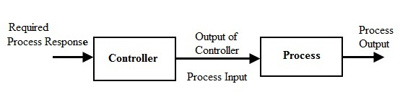

Slide 10
3 rad/s
2.2 rad/s

Slide 11
Required Velocity
Output Velocity
3 rad/s
2.2 rad/s

Slide 12
Open Loop Control
Required Velocity
Output Velocity
3 rad/s
2.2 rad/s

Slide 13
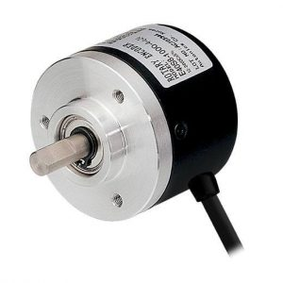
Let’s measure the actual angular velocities.
Now we can compensate for changes in load by feeding back some information.

Slide 14
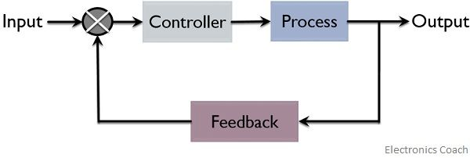
Closed Loop Control

Slide 15
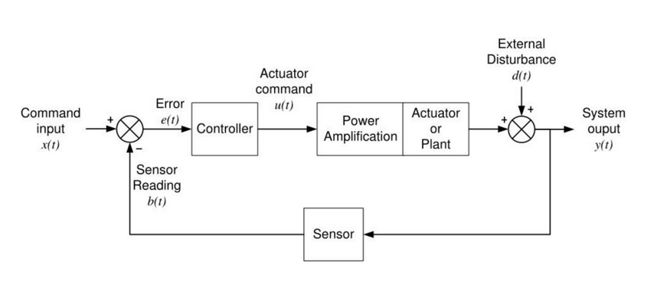
Feedback Diagram

Slide 16
Block Diagram
G
X
Input
Y
Output
Y = X*G
Y/X = G
Gain = Y/X= Output/Input

Slide 17
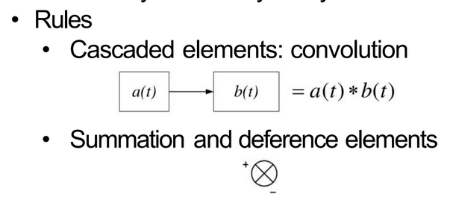
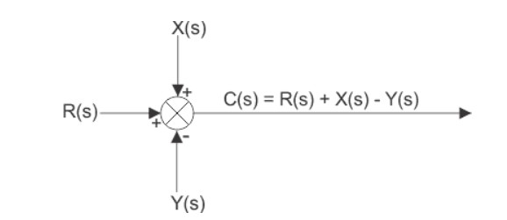
Block Diagram

Slide 18
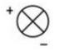
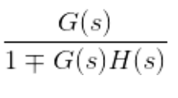
Feedback Connection
X(s)
G(s)
Y(s)
H(s)
*X(s)

Slide 19
Next Class
How to design a control system
How to solve a block diagram
PID Control

Slide 20
Thank You

